Slide 1
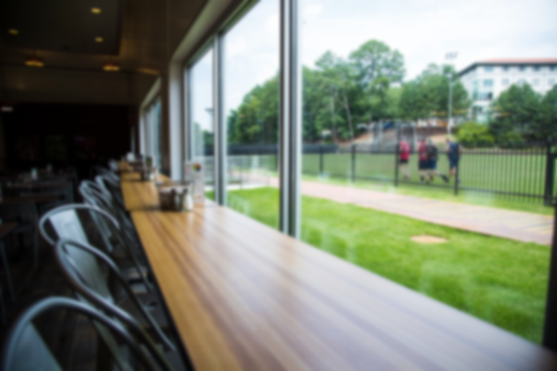
DUC-ling Queue Operations
Team High Five: Abhishek | Sameen | Sharon | Zeyu
Image sourced from Emory university dining, via Google

Slide 2
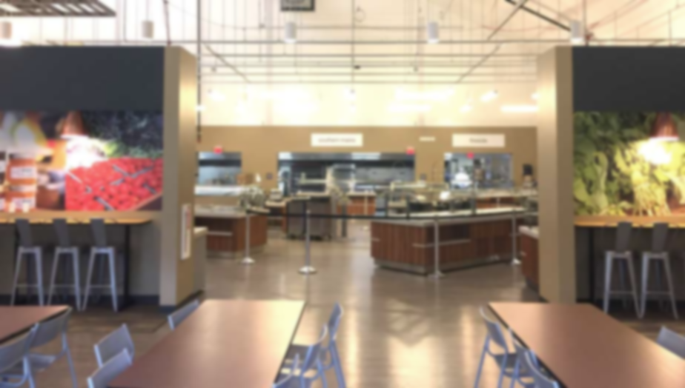
Agenda for today
Our goal and what we learned
Our process
data capture & processing
queue simulation
model validation
Implications & next steps
Image sourced from Emory university dining, via Google

Slide 3
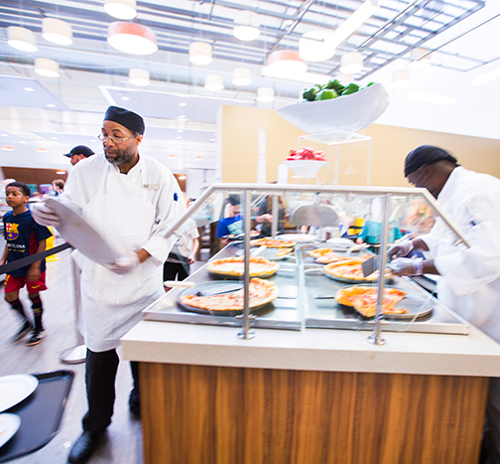
Our goal
Help examine current queuing operations at the DUC-ling using simulation
Identify food stations with high service times and utilization to uncover opportunities for improvement
Image sourced from Emory university dining, via Google

Slide 4
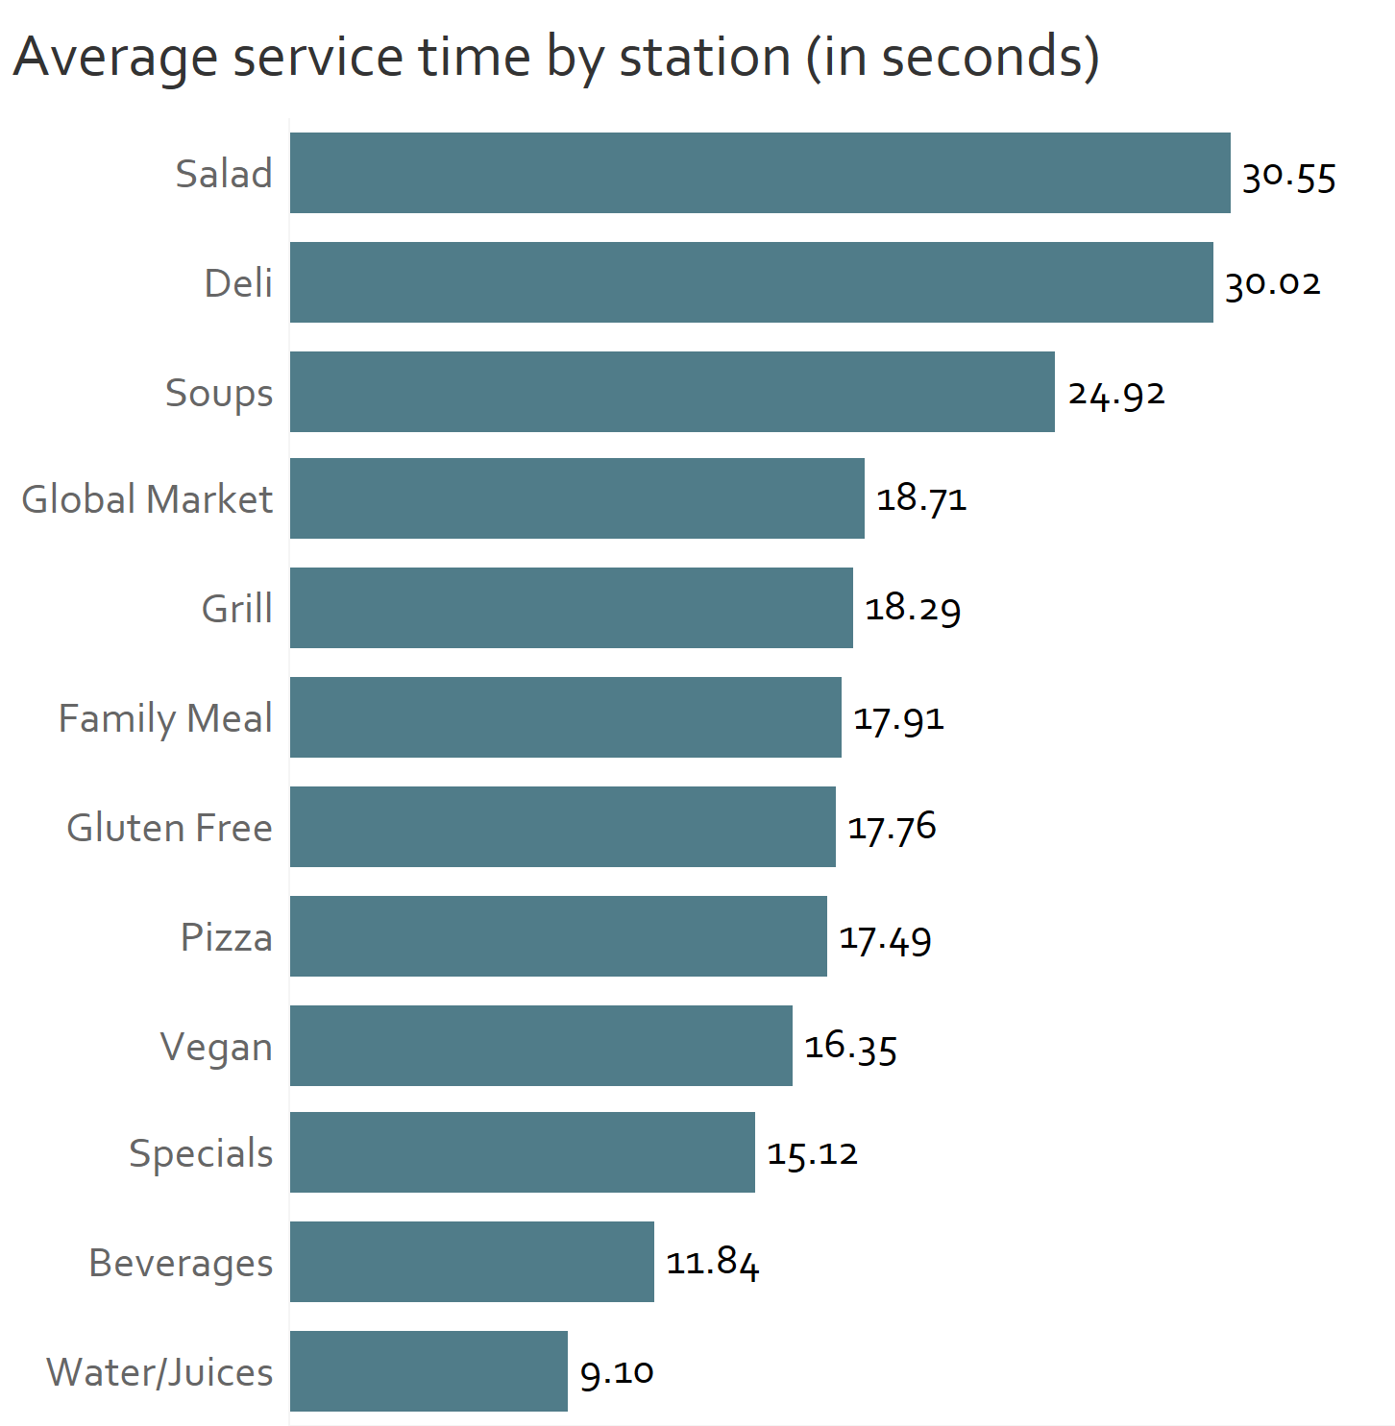
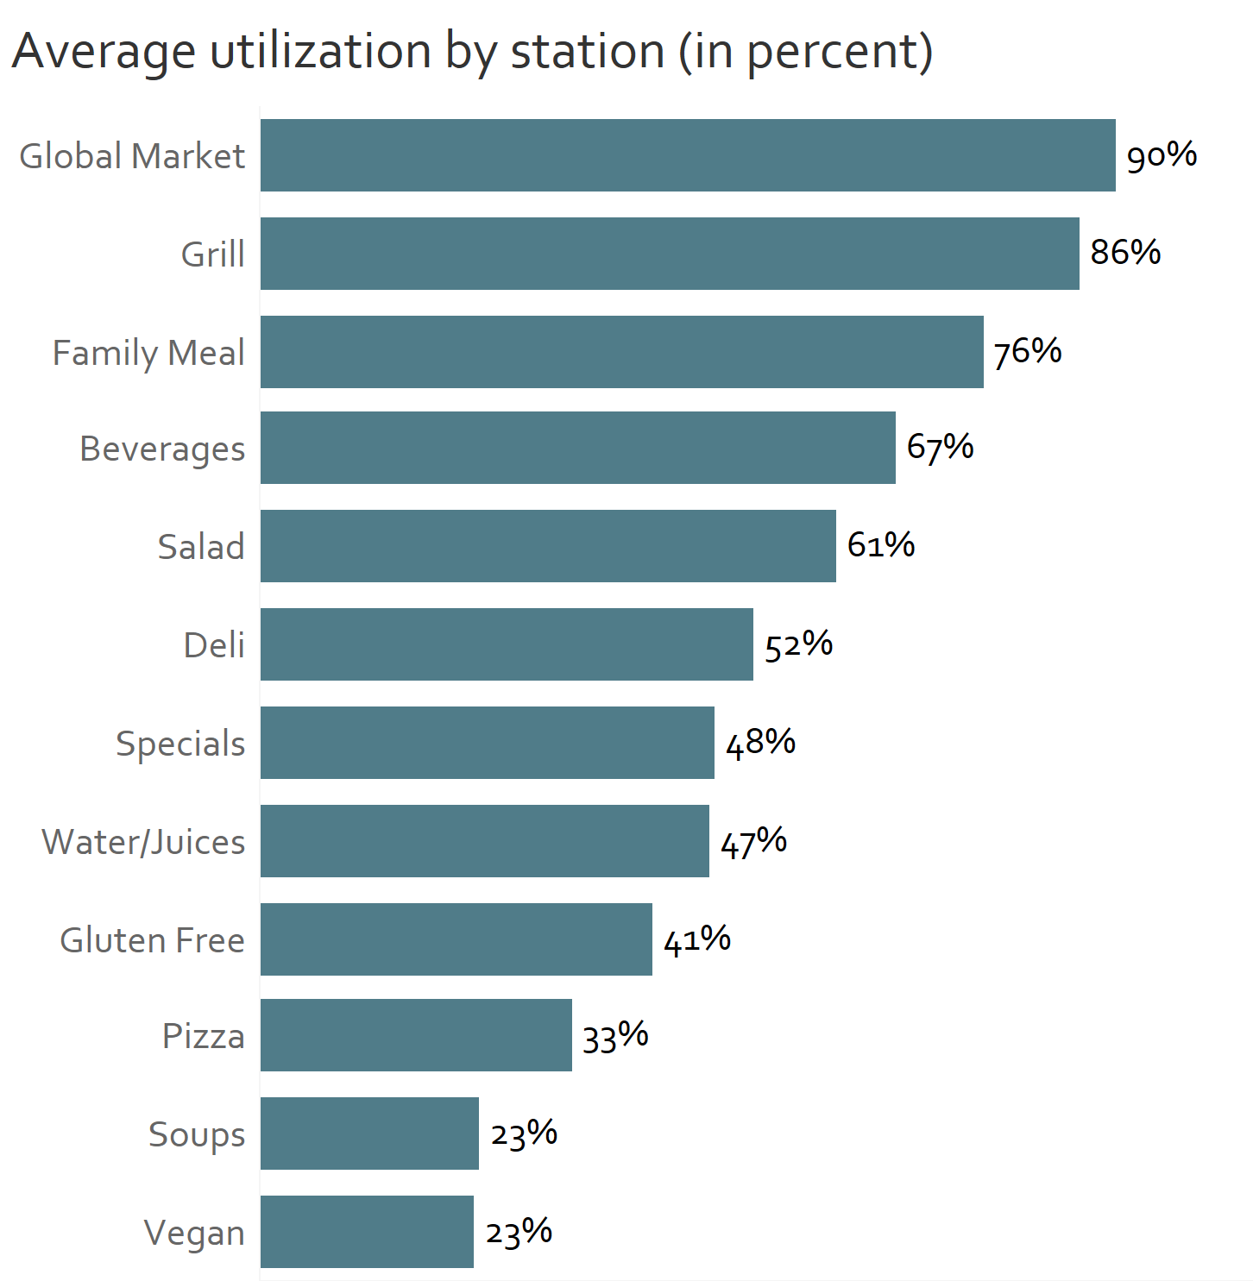
High utilization rates observed for global market and grill, with high service times at self-serve stations like salads and deli

Slide 5
Our process involved 3 key steps for model creation and validation
Data capture & processing
Queue
simulation
Verification & validation
Analyzed data captured via point-of-sale system, dining hall observations, and customer surveys
Simulated queuing operations with 20,000+ customers in-and-out of DUC-ling, based on dining patterns during dinner
Used theoretical frameworks to verify model, and validated results based on business understanding

Slide 6
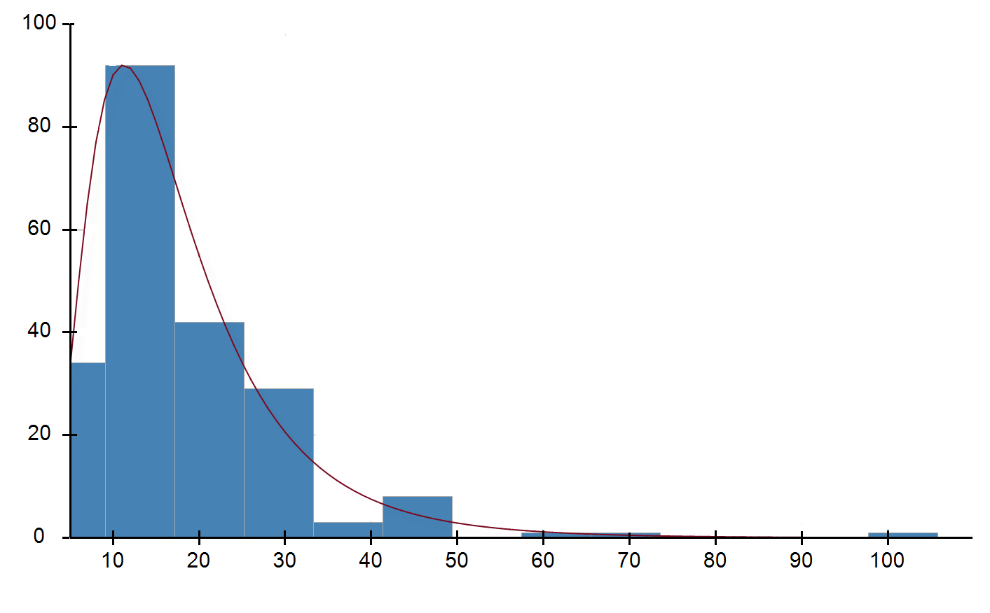
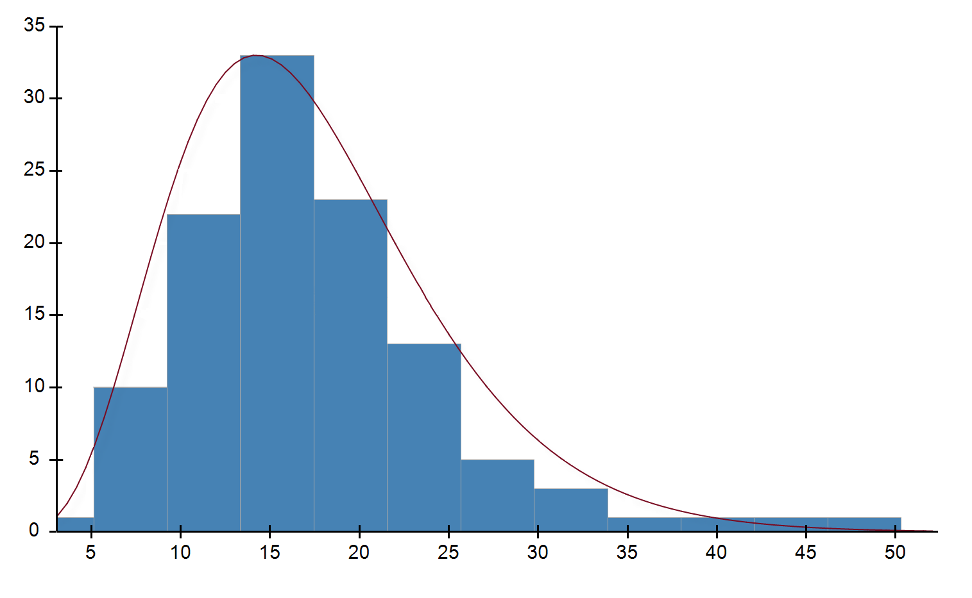
We used arrival and service time data to identify underlying distributions
1
2
Obtained data on the following stations
Services times at 12 food stations
Holding time at tables
Inter-arrival times at point-of-sale system
For other stations
Made reasonable assumptions e.g. 5 seconds to grab a tray
Excluded a few stations that have low traffic e.g. kosher
For each key station:
Used statistical modeling (goodness-of-fit test) to identify distributions that most closely fit the data
Sanity-checked the results visually, and based on what distributions are available in simulation platform
These distributions were then used to model the simulation inter-arrival and service times
Grill service times, fit by log-normal distribution
Pizza service times, fit by gamma distribution

Slide 7
We used survey data to understand path probabilities from one station to the next
1
2
Survey used to understand key pathing behavior, including
entry patterns i.e. customers who grab a table first vs. get food first
food stations visited, in what order
refill tendencies, by station
reneging behavior i.e. which stations people left lines at
Based on these, developed matrix of path probabilities for queue simulation
 | From Station
To Station | Family Meal | Global Market | Grill | Special | Gluten Free | Salad Bar | Pizza | Vegan | Water/Juices | Soups | Beverages | Deli
Family Meal | 0.00 | 0.08 | 0.04 | 0.06 | 0.02 | 0.04 | 0.05 | 0.08 | 0.04 | 0.00 | 0.01 | 0.06
Global Market | 0.31 | 0.00 | 0.09 | 0.02 | 0.07 | 0.03 | 0.04 | 0.04 | 0.01 | 0.06 | 0.01 | 0.00
Grill | 0.12 | 0.18 | 0.00 | 0.06 | 0.05 | 0.07 | 0.07 | 0.08 | 0.01 | 0.06 | 0.01 | 0.06
Special | 0.06 | 0.12 | 0.08 | 0.00 | 0.07 | 0.01 | 0.04 | 0.08 | 0.01 | 0.06 | 0.00 | 0.00
Gluten Free | 0.07 | 0.04 | 0.02 | 0.04 | 0.00 | 0.02 | 0.07 | 0.12 | 0.03 | 0.03 | 0.00 | 0.00
Salad Bar | 0.09 | 0.09 | 0.26 | 0.24 | 0.16 | 0.00 | 0.09 | 0.15 | 0.04 | 0.15 | 0.03 | 0.18
Pizza | 0.07 | 0.05 | 0.08 | 0.11 | 0.14 | 0.07 | 0.00 | 0.00 | 0.04 | 0.03 | 0.01 | 0.00
Vegan | 0.04 | 0.01 | 0.03 | 0.04 | 0.07 | 0.02 | 0.04 | 0.00 | 0.00 | 0.00 | 0.00 | 0.00
Water/Juices | 0.04 | 0.12 | 0.06 | 0.06 | 0.12 | 0.23 | 0.04 | 0.19 | 0.00 | 0.09 | 0.07 | 0.18
Soups | 0.02 | 0.04 | 0.00 | 0.09 | 0.09 | 0.08 | 0.02 | 0.12 | 0.00 | 0.00 | 0.00 | 0.00
Beverages | 0.02 | 0.09 | 0.16 | 0.09 | 0.07 | 0.09 | 0.14 | 0.04 | 0.11 | 0.29 | 0.00 | 0.12
Deli | 0.01 | 0.01 | 0.01 | 0.02 | 0.05 | 0.03 | 0.05 | 0.00 | 0.04 | 0.03 | 0.05 | 0.00
Table | 0.15 | 0.17 | 0.15 | 0.19 | 0.09 | 0.29 | 0.37 | 0.12 | 0.67 | 0.21 | 0.80 | 0.41

Slide 8
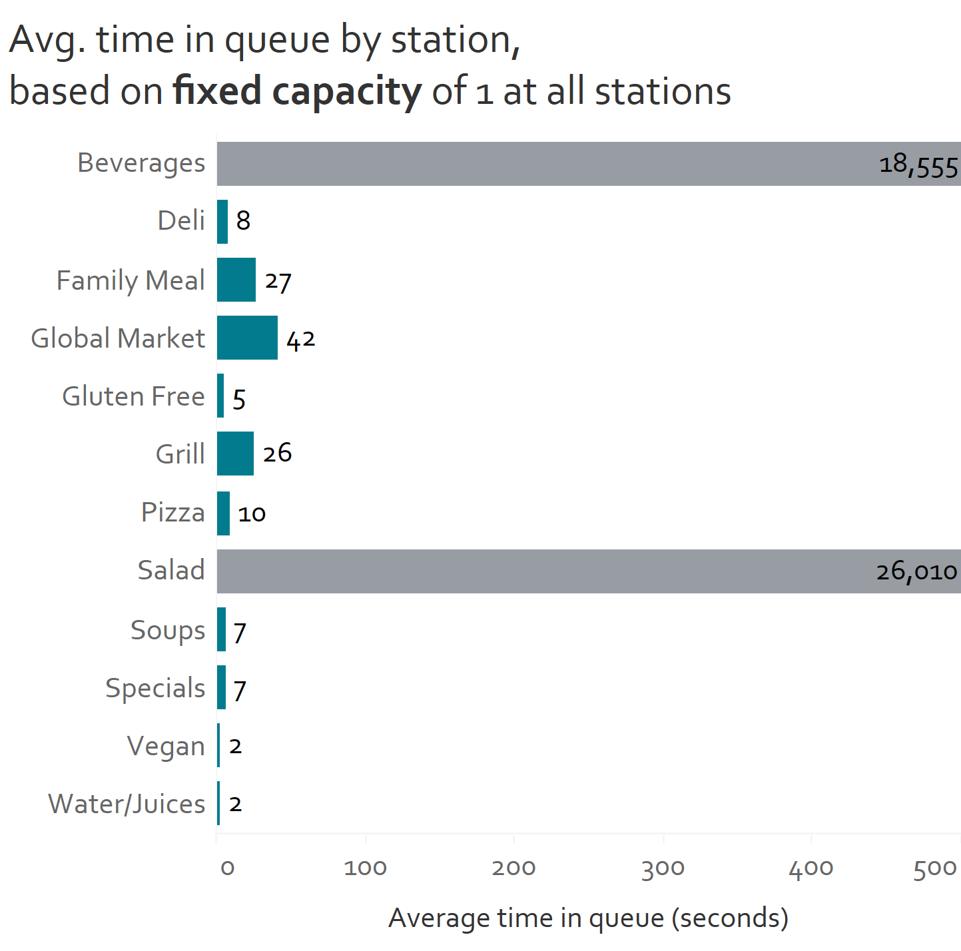
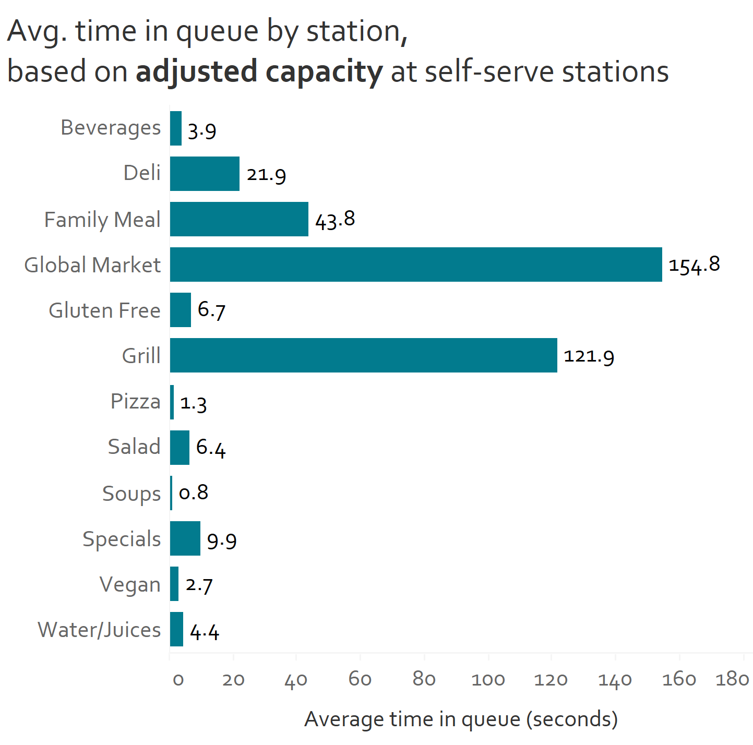
To create our model, we tested multiple capacity levels for self-serve stations to produce results in line with business operations
Skewed wait times observed for beverages and salad using fixed capacity
Capacity adjustment enabled more realistic performance of stations
Final model created based on adjusted capacity of 2 servers for pizza, soup, 3 for salad and beverages

Slide 9
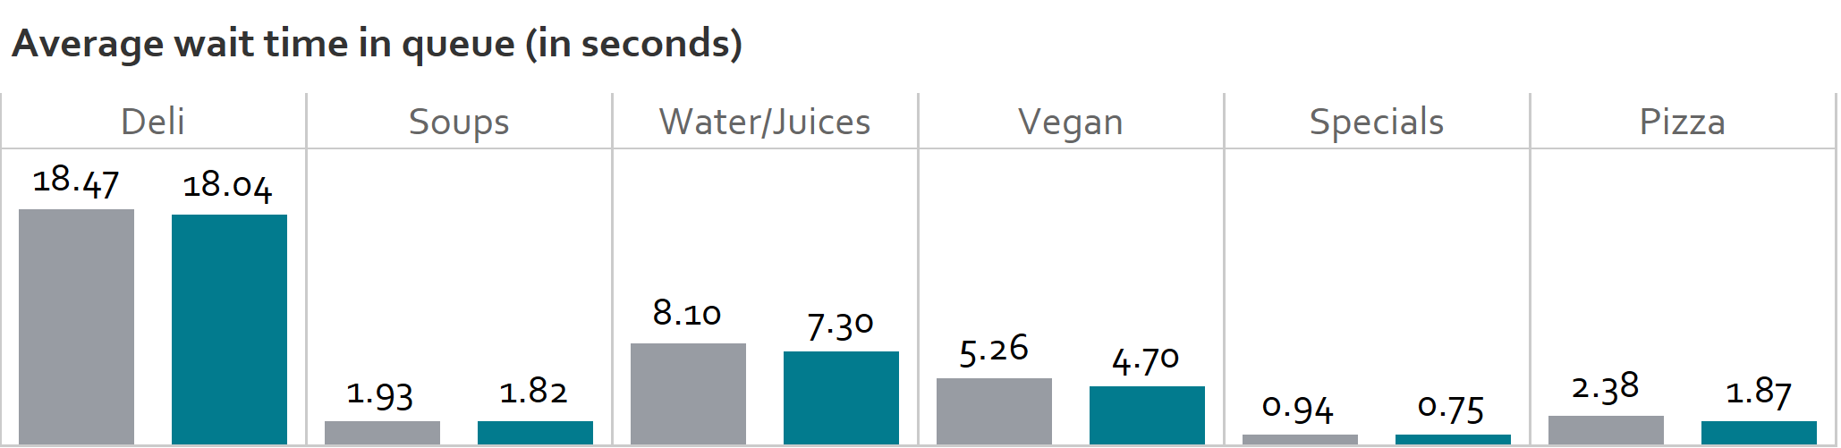
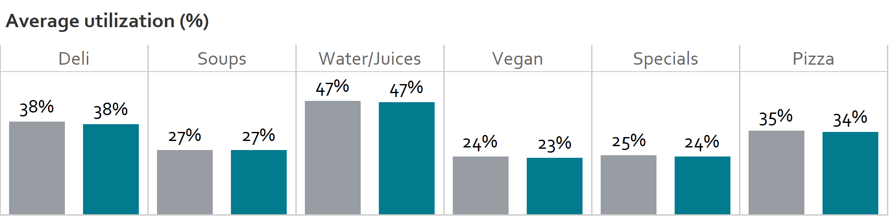
To verify model functionality, we compared M/M/s model simulation output with analytical results by station
Illustrative example for selected stations, no meaningful differences in average queue time or utilization observed
Note: results reflect model simulation using exponential distributions assumed for all station service times. Verification results are directional only, because analytical results relied on equal visit probabilities while simulation was weighted based on network routing. Hence, only limited stations were used for verification where noise from probability was low.

Slide 10
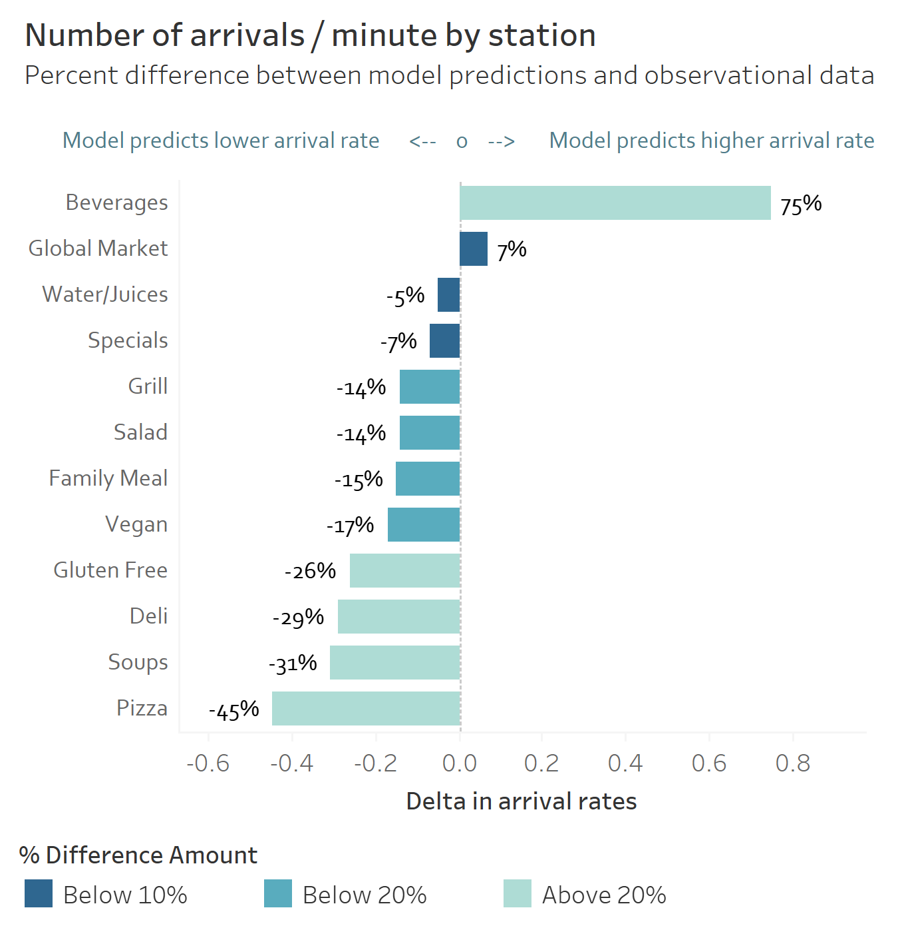
To validate model results, we compared arrival rate predictions from simulation vs. results from observational data
Implications
For select stations, e.g. global market, water/juices and specials, simulation is reasonably similar to observational results
However, non-trivial differences in arrival rate observed for multiple stations especially pizza & beverages
In general, the model appears to underpredict arrival rates for most stations
This may be due to discrepancies in visit probability from survey vs. observational data

Slide 11


Important considerations & potential next steps
Important considerations
Potential next steps
Model represents simplified view of DUC-ling operations, using a subset of all stations
Relies on limited data capture, with manual data collected during one weekday dinner time period only
Used self-reported routing for determining path probabilities, which may not be in line with reality – as observed during validation
Service time distributions may be overfitting on small sample of observational data
For employee-manned stations, a fixed capacity of 1 was used to readily design a simulation, does not capture rotating workers
Opportunity to explore ways to improve high utilization at grill and global market
Basic experiments indicate that doubling the number of servers will halve station service times, although cost needs to be factored in
To improve the accuracy and applicability of queue simulation,
additional observation data is recommended, especially at other times/days. This will also help in distribution estimates.
Larger scale survey may be beneficial in getting more accurate path probabilities. Ideally, this should be validated via observational data
Ultimately, a more complex model could be built to capture additional nuances in operations

Slide 12
Thank you!
Questions?
Image sourced from Emory university dining, via Google

Slide 13
Appendix

Slide 14
Appendix 1: Important caveats and model assumptions
Model represents simplified view of DUC-ling operations, with a subset of stations and an infinite queue assumed
Relies on limited data capture, with observational and survey data collected during one weekday dinner time period only
Used self-reported routing for determining path probabilities, which may not be in line with reality – as observed during validation
Service time distributions may be overfitting on small sample of observational data
For employee-manned stations, a fixed capacity of 1 was used to readily design a simulation. However, the true system involves rotating workers who assist at stations with long queues.
Limited capture of reneging and balking behavior. For reneging, a fixed probability was used for each station, although probability is actually conditional on queue length
For refills, only the first station visited was included in the model. For any additional stations visited, the first-time visit probability is used. This was done due to limitations in data available.
For individuals who grab a table straight away upon entry, the model does not accurately capture tables being blocked from other customers
The model used approximate path distances to determine walking time in the simulation, may not accurately capture actual travel time between stations

Slide 15
Appendix 2: Distributions identified for each station
Station | No. of observations | Distribution fitted
Point-of-sale | 861 | Log Normal
Table | 206 | Gamma
Soup | 43 | Gamma
Salad | 106 | Gamma
Pizza | 114 | Gamma
Pasta | 109 | Logistic
Juice | 205 | Log Normal
Grill | 211 | Log Normal
Global Market | 181 | Log Normal
Family Meal | 127 | Log Normal
Deli | 102 | Weibull
Beverages | 101 | Log Logistic
Gluten Free | 128 | Gamma
Vegan | 76 | Weibull

Slide 16
Appendix 2: Probabilities identified for each route
 | From food station
To station | Family Meal | Global Market | Grill | Special | Gluten Free | Salad Bar | Pizza | Vegan | Water/Juices | Soups | Beverages | Deli | Tray | Table
Family Meal | 0.00 | 0.07 | 0.04 | 0.05 | 0.02 | 0.04 | 0.05 | 0.07 | 0.03 | 0.00 | 0.01 | 0.05 | 0.22 | 0.19
Global Market | 0.29 | 0.00 | 0.09 | 0.02 | 0.07 | 0.03 | 0.03 | 0.03 | 0.01 | 0.06 | 0.01 | 0.00 | 0.18 | 0.10
Grill | 0.11 | 0.17 | 0.00 | 0.05 | 0.04 | 0.06 | 0.06 | 0.07 | 0.01 | 0.06 | 0.01 | 0.05 | 0.17 | 0.12
Special | 0.06 | 0.11 | 0.08 | 0.00 | 0.07 | 0.01 | 0.03 | 0.07 | 0.01 | 0.06 | 0.00 | 0.00 | 0.08 | 0.05
Gluten Free | 0.07 | 0.04 | 0.02 | 0.04 | 0.00 | 0.02 | 0.06 | 0.10 | 0.02 | 0.03 | 0.00 | 0.00 | 0.07 | 0.01
Salad Bar | 0.09 | 0.08 | 0.25 | 0.23 | 0.16 | 0.00 | 0.08 | 0.14 | 0.03 | 0.15 | 0.02 | 0.14 | 0.07 | 0.06
Pizza | 0.07 | 0.05 | 0.08 | 0.11 | 0.13 | 0.06 | 0.00 | 0.00 | 0.03 | 0.03 | 0.01 | 0.00 | 0.07 | 0.12
Vegan | 0.03 | 0.01 | 0.03 | 0.04 | 0.07 | 0.02 | 0.03 | 0.00 | 0.00 | 0.00 | 0.00 | 0.00 | 0.04 | 0.00
Water/Juices | 0.03 | 0.11 | 0.06 | 0.05 | 0.11 | 0.20 | 0.03 | 0.17 | 0.00 | 0.09 | 0.05 | 0.14 | 0.03 | 0.12
Soups | 0.02 | 0.04 | 0.00 | 0.09 | 0.09 | 0.07 | 0.02 | 0.10 | 0.00 | 0.00 | 0.00 | 0.00 | 0.02 | 0.04
Beverages | 0.02 | 0.08 | 0.15 | 0.09 | 0.07 | 0.08 | 0.13 | 0.03 | 0.09 | 0.29 | 0.00 | 0.09 | 0.02 | 0.16
Deli | 0.01 | 0.01 | 0.01 | 0.02 | 0.04 | 0.03 | 0.05 | 0.00 | 0.03 | 0.03 | 0.04 | 0.00 | 0.00 | 0.01
Table | 0.15 | 0.16 | 0.14 | 0.18 | 0.09 | 0.25 | 0.33 | 0.10 | 0.55 | 0.21 | 0.64 | 0.32 | 0.00 | 0.00
At station | Probability of reneging
Family Meal | 0.290
Global Market | 0.190
Grill | 0.218
Special | 0.021
Gluten Free | 0.109
Salad Bar | 0.057
Pizza | 0.067
Vegan | 0.037
Water/Juices | 0.089
Soups | 0.069
Drinks | 0.000
Deli | 0.118
Grab Table First? | Probability
Yes | 0.63
No | 0.37
Refill? | Probability
Yes | 0.59
No | 0.41

Slide 17
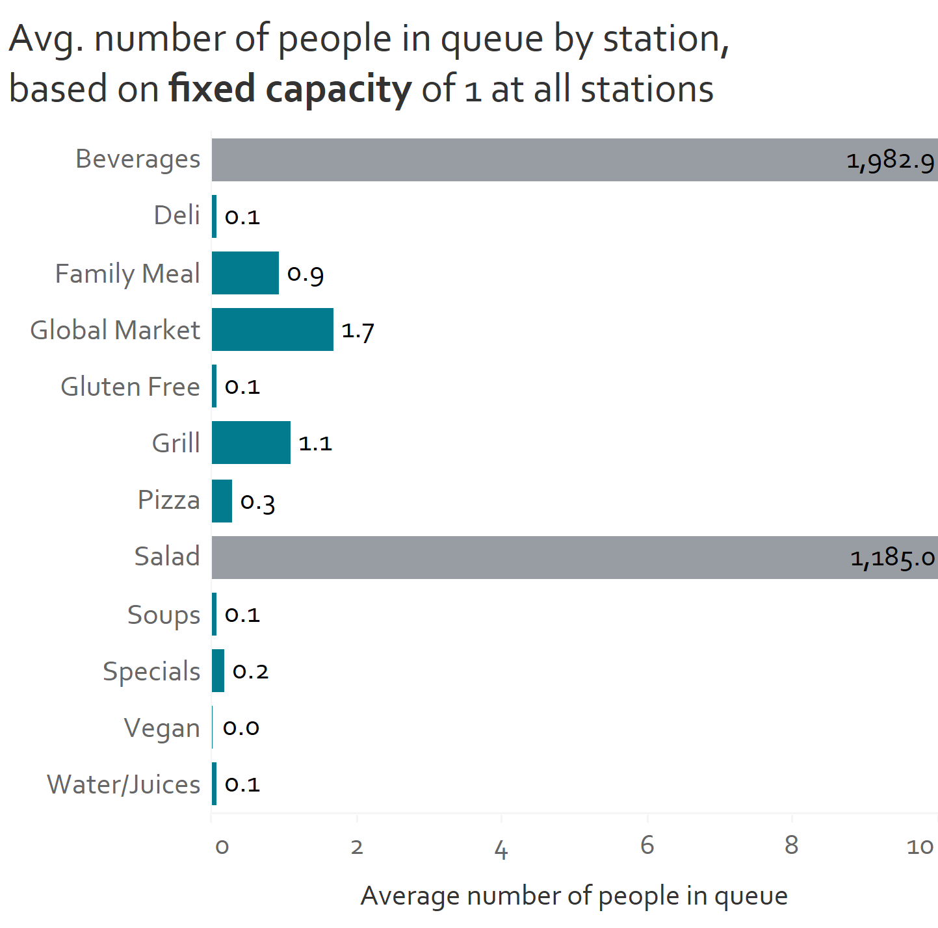
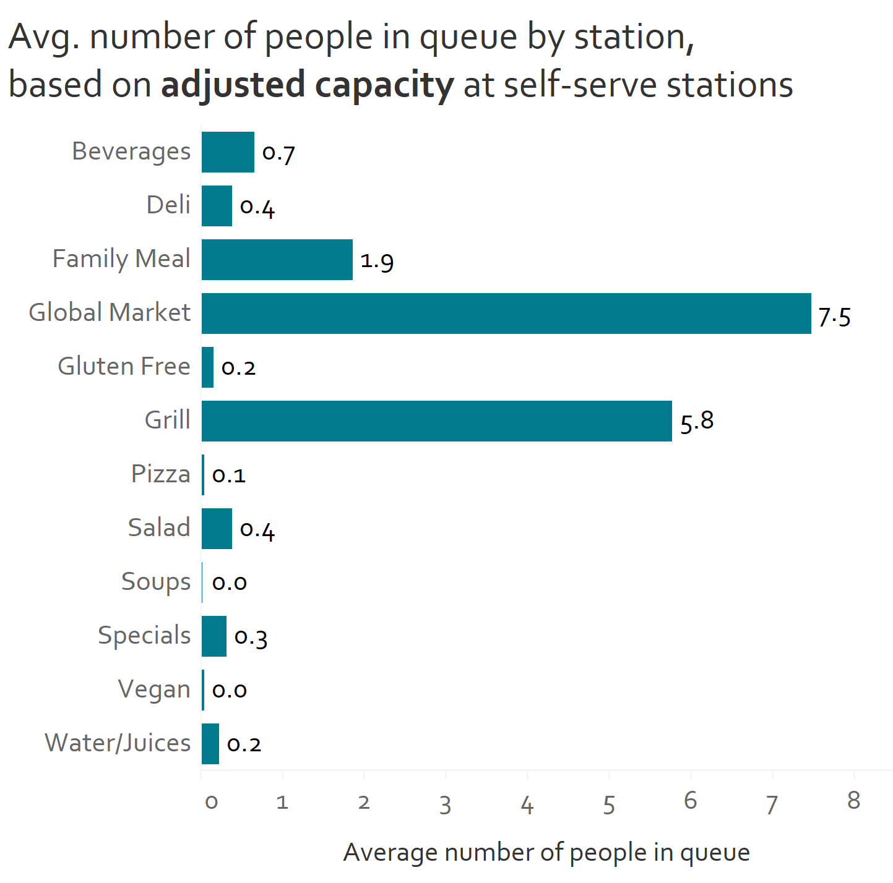
Appendix 3: Queue lengths based on testing different capacity levels at self-serve stations
Skewed queue lengths observed for beverages and salad using fixed capacity
Capacity adjustment enabled more realistic performance of stations

